Slide 1


JOB ANALYTICS
Prediction using Machine Learning Algorithm

Slide 2




TEAM MEMBERS
AKASH VYAS
PT DA18_014
HARSH AGRAWAL
PT DA18_059
HARIHARAN
PT DA18_022
TUNEER DUTTA
PT DA18_075

Slide 3

TABLE OF CONTENTS
1. INTRODUCTION
2. ROADMAP
3. INSIGHTS
4. SKILL SEARCH MODEL
5. CHALLENGES FACED
6. FUTURE SCOPE
7. CONCLUSION

Slide 4

INTRODUCTION
Instahyre is an advanced hiring platform based on artificial intelligence, enabling recruiters to hire top talent effortlessly.
Trusted by 10,000+ companies including Google, Amazon, Flipkart, Microsoft, Uber, Walmart, Swiggy, and more!

Slide 5

INTRODUCTION
PROBLEM STATEMENT :
To help Job seekers and career professionals with the information they need to make informed decisions about their careers.
To Develop an user-friendly application to find relevant job opportunities and gain insights based on their skill set.

Slide 6

INTRODUCTION
OBJECTIVES :
Develop an application that provides useful insights and
relevant job openings based on skills.
The goal is to help job seekers and professionals to gain a better understanding of job market, including the most common location, experience level, relevant class, and total number of jobs available.
The application should be scalable and should be able to accommodate the addition of new features in the future.

Slide 7





ROADMAP
WEB SCRAPING
DATA CLEANING
GENERATE INSIGHTS
Web Scraping using Python library Selenium.
Data Cleaning using Excel & Python.
Insight Generation using SQL and Power BI.
MODEL BUILDING
MODEL DEPLOYMENT
ML Model Building Using Sci-kit Learn.
Model Deployment using Stream-lit.

Slide 8
INSIGHTS
Most of the listed companies on Instahyre have low LinkedIn Followers.
Massive Following : Followers more than 50K
Low Following : Followers less than 50K

Slide 9
INSIGHTS
Companies Founded after year 2000 have the most Job Opportunities.
Early : 1841 – 1950
Mid : 1951 – 1999
Recent : 2000 – 2014
Start-up : 2015 – Present

Slide 10
INSIGHTS
IT Jobs are high in demand.
Software Engineer is the most demanding designation in the market.

Slide 11
INSIGHTS
Job opportunities are higher for experienced candidates as compared to entry-level freshers.

Slide 12
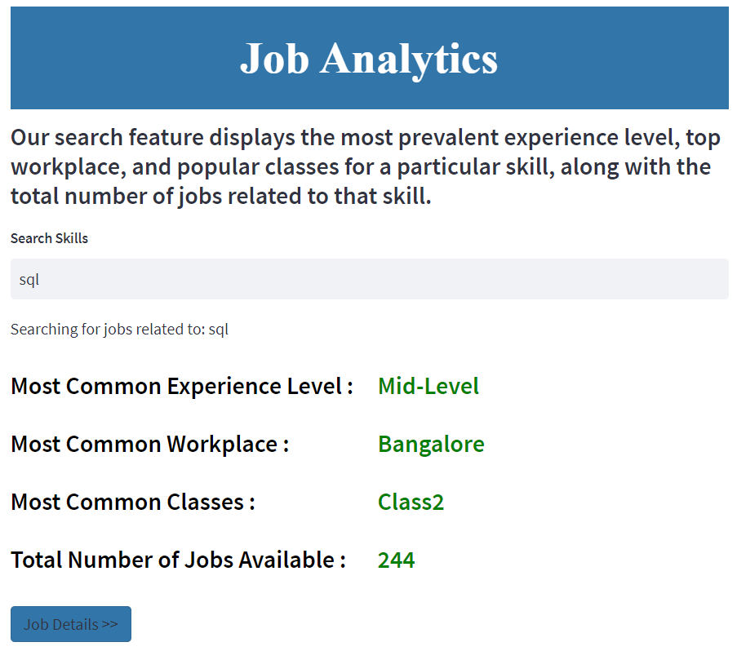

SKILL SEARCH MODEL

Slide 13
CHALLENGES FACED
Scraping LinkedIn followers of different companies without getting banned was a challenging task.
Proper integration of SpellChecker consumed a lot of time.
After ML model deployment, It took us some time and efforts to get familiar with HTML and CSS language for designing UI.

Slide 14

FUTURE SCOPE
This project can be used to help job seekers identify suitable job opportunities based on their skills
This can save job seekers time and effort in their job search and increase the chances of them finding a job that matches their Skills.
This project can have a positive social impact by helping job seekers from diverse background, find meaningful employment opportunities and reducing unemployment rates.

Slide 15

CONCLUSION
The project successfully provides insights into the job market for popular skills like Python and SQL, which can be valuable for job seekers, employers and industry analysts alike.
The analysis of the most common location, experience level, and job classes can be used by job seekers to target their job search and improve their chances of finding a relevant job. Similarly, employers can use this information to refine their hiring strategies and tailor job requirements to the current job market.

Slide 16

THANK YOU!

